Slide 1
USE CASE
ADD TITLE / PURPOSE OF THE USE CASE
e
Describe info exchange
Paste
organization
icon here
Paste patient icon here
Paste
organization
icon here
Describe info exchange
Describe info exchange
Add Icon Description
Describe info exchange
Add Icon Description
Describe Goal
Describe Goal
Describe Goal
Describe Goal
Describe Goal
GOALS
Icons provided by MeHI at mehi.masstech.org/Icons

Slide 2
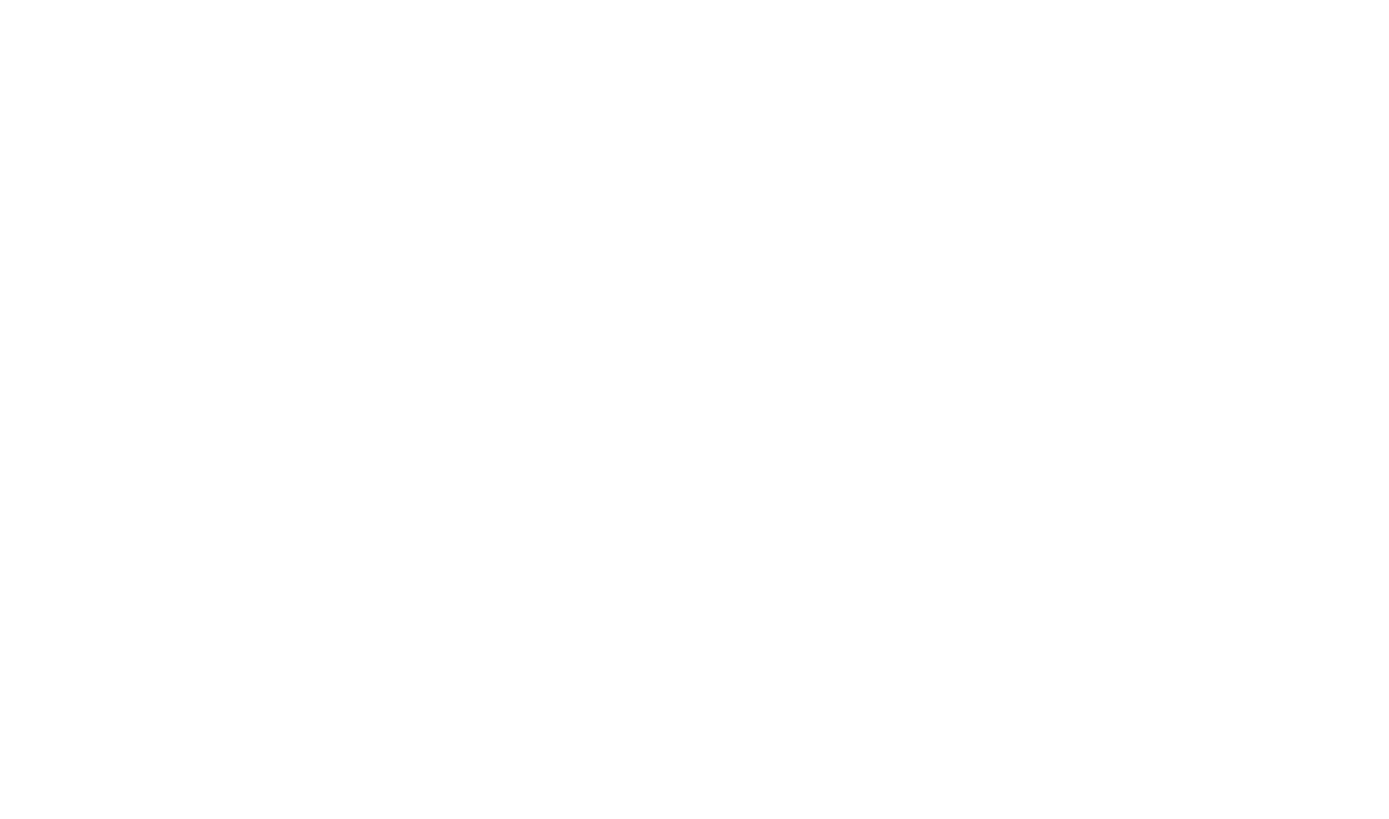
USE CASE
ADD TITLE / PURPOSE OF THE USE CASE
ORGANIZATIONS
STORY
Describe organizations
Describe in story format:
The type of patient(s) affected by the exchange
When, why, how the information will be exchanged by the initiating organization to the other organization
When, why, how the other organization will respond with updated information
GOAL
Describe goal(s)
TRADING PARTNERS AND SYSTEMS
List organization 1
List organization 2
DATA TO EXCHANGE
Describe the information to be exchanged
Icons provided by MeHI at mehi.masstech.org/Icons

