Slide 1
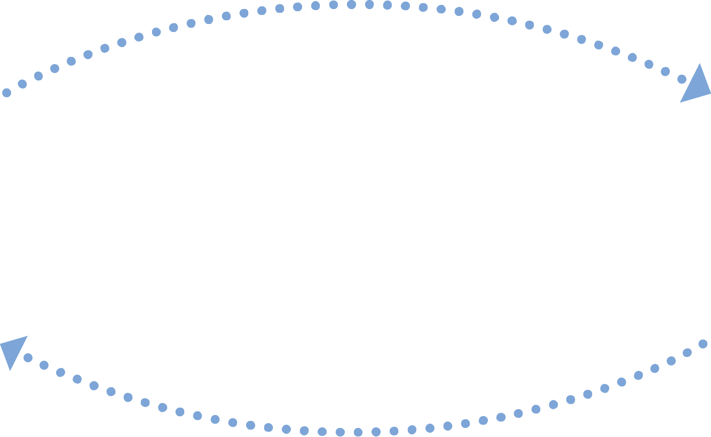


LAB EXCHANGE
USE CASE
LAB RESULTS FROM HOSPITAL LAB TO HOME CARE AGENCY
Lab Order
HOME CARE AGENCY
(Gardner VNA)
HOSPITAL LAB
(Heywood Hospital)
Lab Results
Enhance care coordination and efficient lab results communication leading to: improved patient safety, reduced costs associated with lab results management and reduction in results communication to visiting nurses in the community.
GOAL
Icons provided by MeHI at mehi.masstech.org/Icons

Slide 2

LAB EXCHANGE
USE CASE
LAB RESULTS FROM HOSPITAL LAB TO HOME CARE AGENCY
ORGANIZATION
STORY
Heywood Hospital and Gardner Visiting Nursing Association.
Heywood Hospital, in partnership with the Gardner Visiting Nurses Association (GVNA), proposes to strengthen their collaborative network by improving the coordination and continuum of care for post-discharge patients residing in North Central Massachusetts. GVNA will achieve this by developing an electronic exchange of lab results, via the Mass HIway.
The GVNA received 654 referrals from Heywood Hospital and provided more than 35,000 visits. The project objectives include a more effective sharing of lab results which will lead to improved patient safety, increased efficiency and reduced costs associated with lab result exchange. This inter-collaborative project will increase the amount and accuracy of information available to home care providers at the time of patient transitions, as well as improve the efficiency and exchange of lab results. This will lead to improvements in the quality of care, improved population health and a reduction in care costs.
Workflow:
Currently, the lab order is done via a paper requisition and accompanies the patient to the lab after GVNA or the patient’s primary care physician orders the lab. Once Heywood receives the order, GVNA patients are entered with a specific location code and this is used to filter the results so only those are sent to GVNA. Once the lab work is completed, the results are passed to the Heywood Iatric interface engine which does the filtering and sends the appropriate results through from Heywood o GVNA via the HIway. The result is then passed to an FTP server and sent to the McKesson hosted environment. The Lab result is then accepted into GVNA’s McKesson Home Health system where the result is attached to the patient record for review and follow-up.
GOAL
Enhance care coordination
Establish connectivity to the Mass HIway
TRADING PARTNERS AND SYSTEMS
Heywood Hospital - acute care hospital (primary sender), using Iatric interface engine and the Mass HIway;
Gardner VNA - home health agency (primary receiver), using McKesson Home Health System and the Mass HIway.
DATA TO EXCHANGE
Paper Lab Order;
HL7 Lab Results.
Icons provided by MeHI at mehi.masstech.org/Icons

