Slide 1
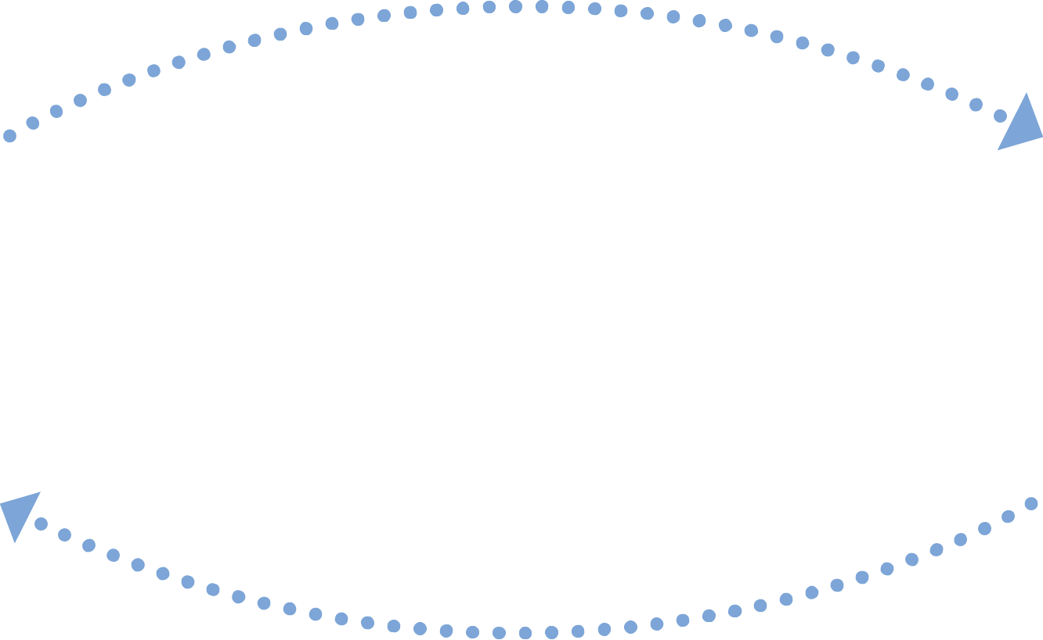


CLOSED LOOP REFERRALS
USE CASE
REFERRAL AND DOCUMENT EXCHANGE BETWEEN
PRIMARY CARE PHYSICIAN AND SPECIALIST
Referral form and
Summary of Care Document
PRIMARY CARE PHYSICIAN
SPECIALTY
PROVIDER
Consult Notes
or
Summary of Care Document
To improve care coordination and achieve the Meaningful Use HIE objective.
GOAL
Icons provided by MeHI at mehi.masstech.org/Icons

Slide 2

CLOSED LOOP REFERRALS
USE CASE
REFERRAL AND DOCUMENT EXCHANGE BETWEEN
PRIMARY CARE PHYSICIAN AND SPECIALIST
ORGANIZATION
STORY
Ambulatory Practice to Specialty Practice.
The primary care physician (PCP) of Practice A identifies the need for a patient to see a specialist. The PCP sends a referral request form along with the patient’s summary of care document to the specialist at Practice B. The PCP will do this by searching for the specialist in the Mass HIway Directory accessible via the PCP’s EHR then sending the referral form and summary of care document to the specialist’s Mass HIway Direct Address.
Upon receiving the referral request and summary of care for the patient via the HIway, the specialist’s office will schedule an appointment with the patient. After the patient has been seen by the specialist, the specialist will use the Mass HIway to send the consult note to the PCP. The specialist will do this by searching for the PCP
in the Mass HIway Directory then sending the consult note to the PCP’s Mass HIway Direct Address, thus closing the referral loop.
GOAL
To improve care coordination and achieve the Meaningful Use HIE objective.
TRADING PARTNERS AND SYSTEMS
Organization A - ambulatory practice; primary care physician;
Organization B – specialty practice; specialist physician.
EHR Direct Interface.
DATA TO EXCHANGE
Referral Request Form or message;
CCD - Summary of Care document.
Icons provided by MeHI at mehi.masstech.org/Icons

